Slide 1
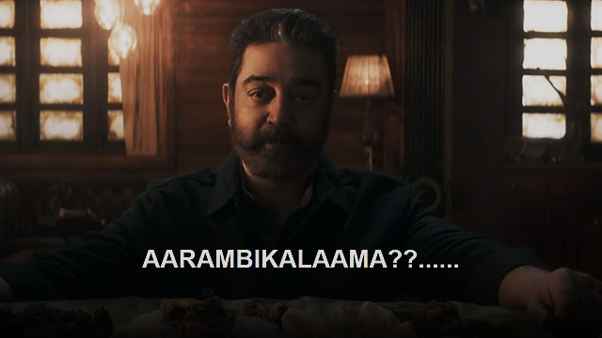

Slide 2

MINI VOICE ASSISTANT
BY
MANIKANDAN KISHORE KUMAR BHAGAVATH RAM THILAK SHANKAR

Slide 3
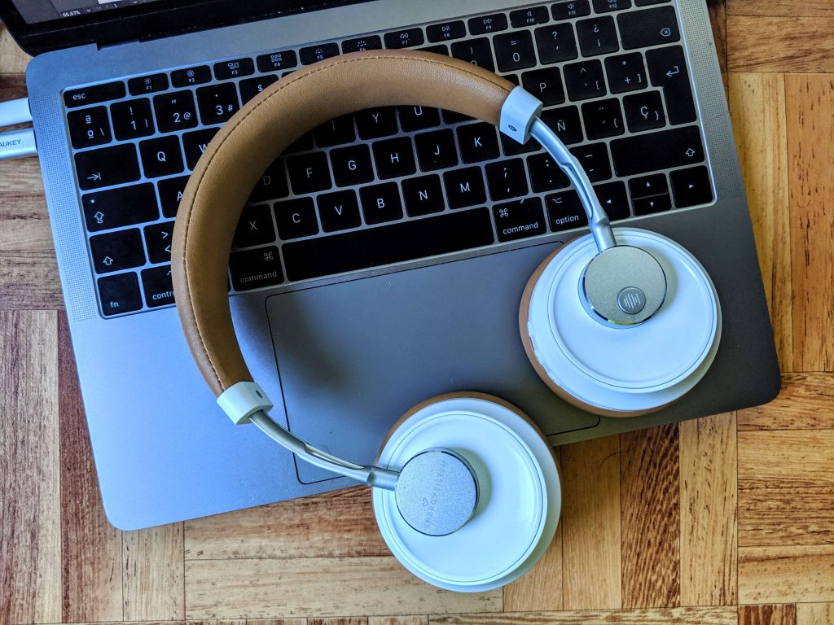
OBJECTIVES
The project aims to develop a mini voice-assistant for the user in system. It draws the inspiration from virtual assistants like Cortana for Windows and Siri for IOS. It has been designed to provide a user-friendly interface for carrying out a variety of tasks by a well- defined commands

Slide 4

INTRODUCTION
We have developed a mini voice assistant that used to find current date and time, Informations, recorrect the spellings and calculate etc by recognizing our voice .

Slide 5

Flow Chart

Slide 6
Start
getting audio()
Take audio
Recognize & convert
speech to text
Execute the commands
End

Slide 7
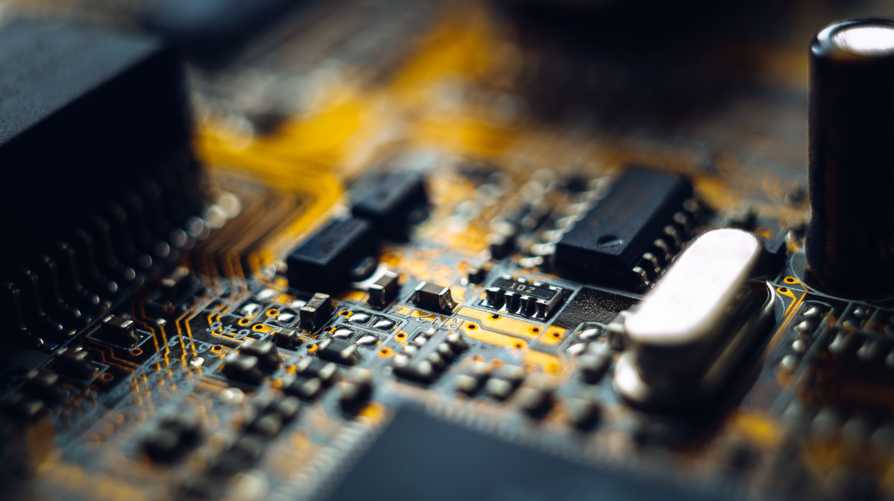
PACKAGES
pyttsx3
datetime
speech_recognition
wikipedia
subprocess
os

Slide 8

OUTPUT

Slide 9
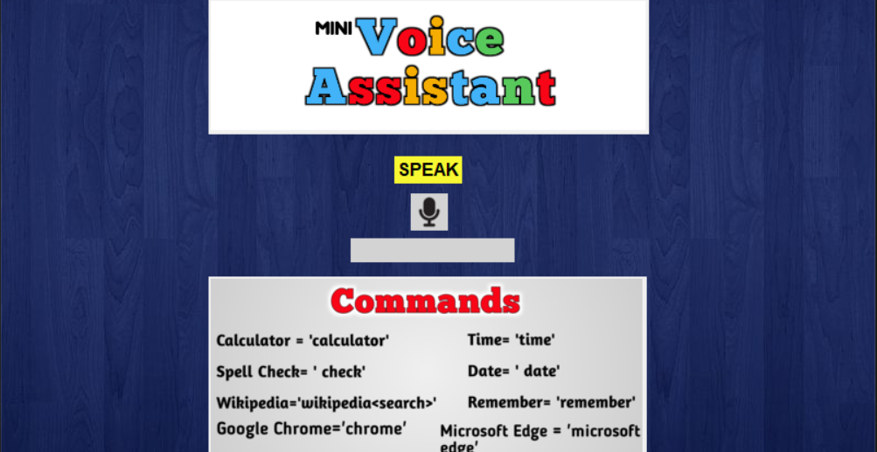

Slide 10
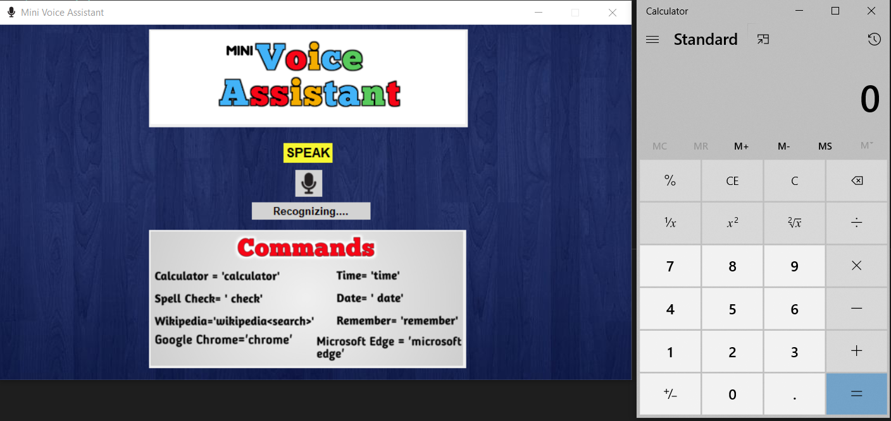

Slide 11
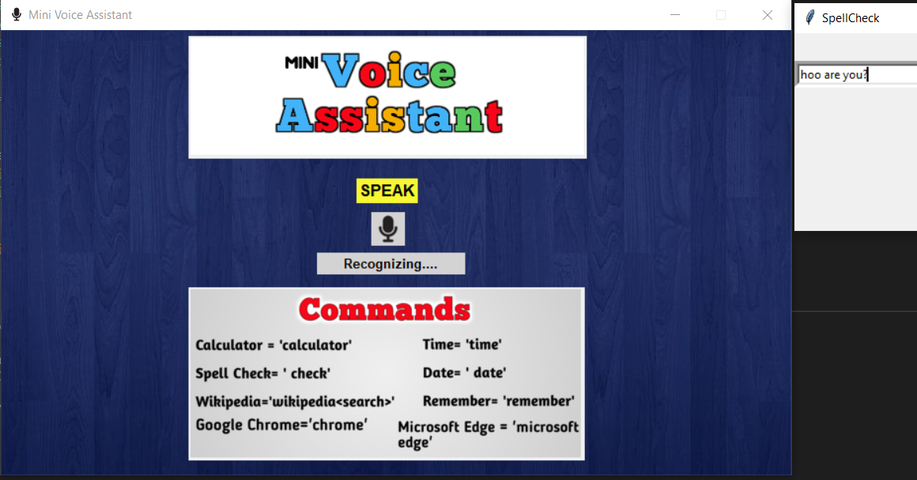

Slide 12

CODING
CLICK HERE

Slide 13

THANK YOU

